Slide 1
CLASS:D10A GROUP NO : 3
TOPIC: CLASSROOM MANAGEMENT
IN PYTHON
SUBTOPIC: CLASSROOM ATTENDANCE
SYSTEM
GROUP MEMBERS:
(BATCH C)
Member 1: Aaditi Surve (53)
Member 2:Piyush Tilokani(57)
Member 3:Shashwat Tripathi(58)
Member 4:Sneha Utekar(60)

Slide 2
CONTENTS
PROBLEM STATEMENT
APPROACH
CODE
OUTPUT
CONCLUSION

Slide 3
PROBLEM STATEMENT
DRAWBACKS OF OFFLINE ATTENDANCE SYSTEM:
Time Consuming.
Inaccuracy.
Difficulty in tracking absenteeism.
Limited Data Analysis.
Lack of real-time monitoring.
OUR ONLINE CLASSROOM ATTENDANCE SYSTEM WILL HELP IN THE FOLLOWING:
Time-saving.
Improved accuracy.
Easy to track absenteeism.
Easy data analysis.
Real-time monitoring.

Slide 4
APPROACH
The main aim of an our online attendance system is to automate the process of tracking attendance, making it more efficient, accurate,paperless and digitally accessible.
SOFTWARE REQUIREMENT :
GUI toolkit :Tkinter
IDE:Pycharm
FUNCTIONALITIES:
Add name
Add Date
Add Subject
Add Time
Submit button
Display Attendance mark message

Slide 5
DIFFERENCE
Tkinter:
Tkinter is a standard Python library for creating graphical user interfaces (GUIs) using the Tk GUI toolkit. It provides a set of pre-built widgets such as buttons, labels, text boxes, and more, that can be used to create a variety of GUIs.
Tkinter is included with Python by default, so no additional installation is required.
CustomTkinter:
CustomTkinter, on the other hand, is not a standard library and refers to a customized version of Tkinter that has been modified to suit a specific project or user's needs.
It may include additional widgets, themes, or functionality that is not present in the standard Tkinter library.

Slide 6
The main difference between Tkinter and CustomTkinter is that Tkinter is a standard Python library for creating GUIs using the Tk toolkit, while CustomTkinter refers to a customized version of Tkinter that has been modified to suit specific needs.

Slide 7
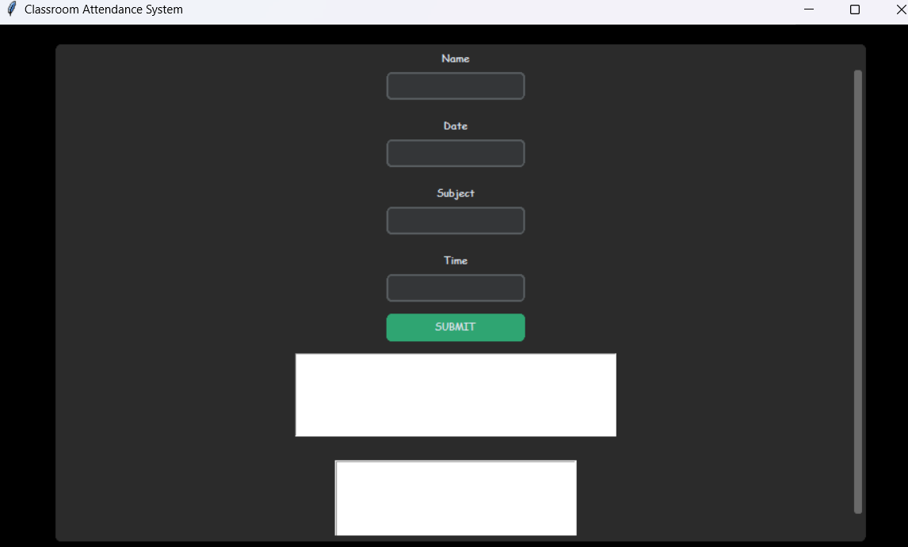
GUI Screenshots

Slide 8
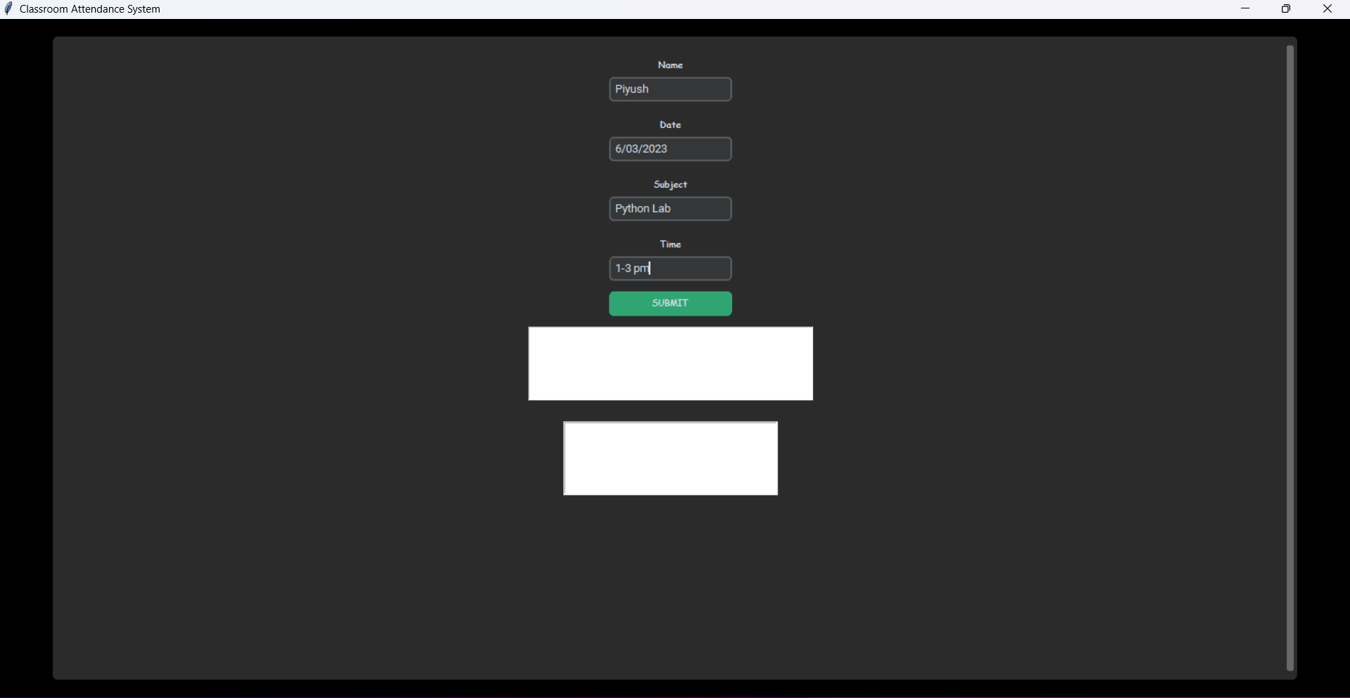

Slide 9
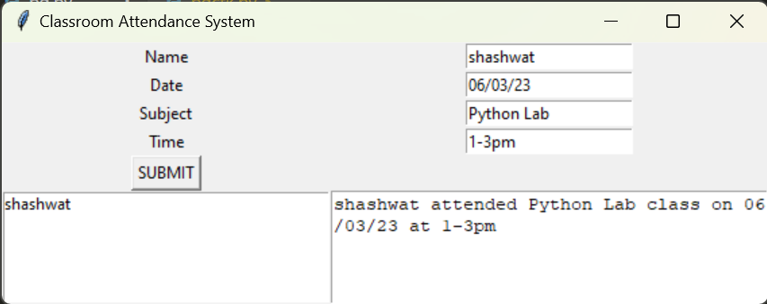

Slide 10
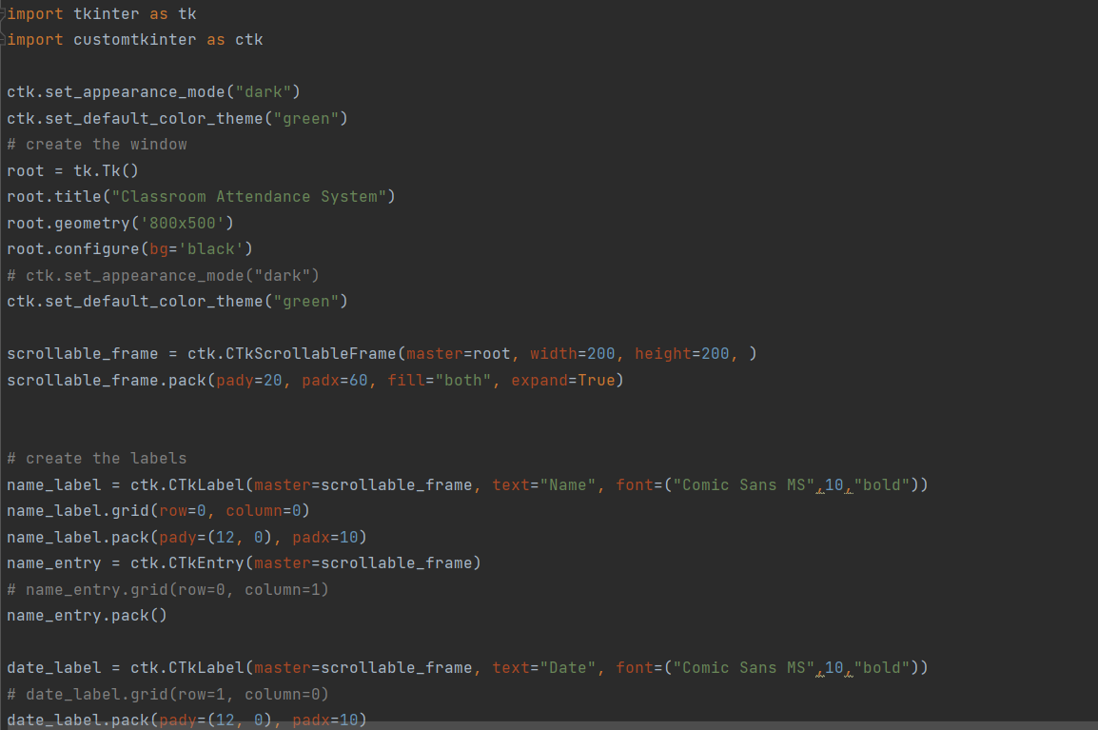
Code

Slide 11
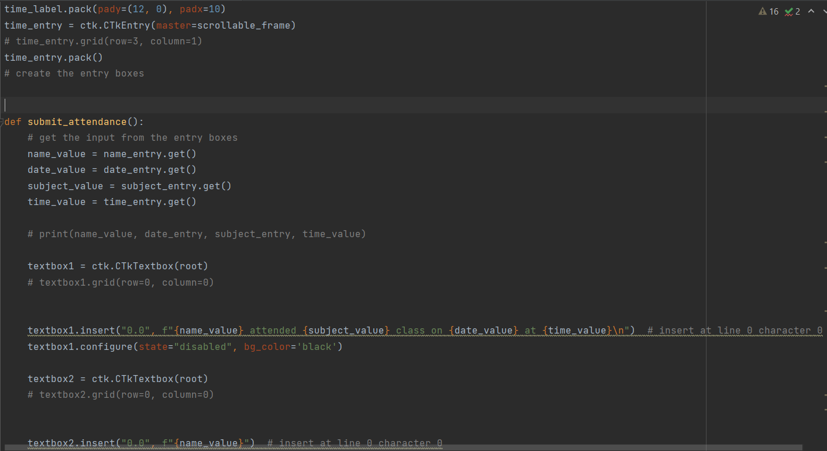

Slide 12
CONCLUSION
The online attendance system project aims to automate attendance tracking, improve accuracy, provide real-time monitoring, and enable data analysis.
The system streamlines attendance-taking processes, eliminates errors, and offers more flexibility and accessibility.
The successful implementation of the online attendance system project requires careful planning, a user-friendly interface, and effective training for users.
With its many benefits, the system can significantly improve classroom operations, reduce administrative workload, and support better decision-making.
Overall, the online attendance system project provides a more efficient, accurate, and accessible way of tracking attendance, benefiting both teachers and students alike.

